Slide 1

Family Food Menu for Healthy Recipes
For Web603 Advanced Full Stack Web
Development
Professor Ghani Zahid
By Dilshodbek Rakhimboev

Slide 2

Agenda:
Introduction
Goals and objectives
Target audience
Key features
Technology requirements

Slide 3
Introduction
The Family Food Menu is a modern web application designed to simplify daily meal planning for families, with a special focus on healthy, homemade, and cultural recipes. Built with a user-friendly design and secure functionality, the app allows users to share, save, and explore a variety of Uzbek and healthy food recipes. The goal is to encourage nutritious eating habits and support family life by minimizing daily stress around meal preparation.

Slide 4
Goals and Objectives
✅ Simplify meal planning for families by offering a structured, recipe-sharing platform.
✅ Promote healthy eating habits through diverse and well-organized recipe listings.
✅ Enable personalization, allowing users to save favorites and post their own recipes.
✅ Enhance user experience with responsive design, authentication, and offline access (PWA).
✅ Maintain data security using modern web security practices such as SSL and cookie-based sessions.

Slide 5
Target Audience
🧕 Families and homemakers looking for easy meal inspiration.
🧑‍🍳 Food enthusiasts who want to share or discover traditional and healthy dishes.
💻 Users who prefer clean, accessible web applications with mobile support.
🔐 Users concerned with privacy and secure access to personal data.

Slide 6
Key Features
🔐 User Authentication: Signup, login, logout with secure authorization and session management.
📖 Recipe Posting: Users can add new recipes including title, description, image, and prep time.
❤️ Favorite Recipes: Save favorite recipes for quick access.
🔍 Recipe Gallery: Browse recipes with images, prep times, and categories.
🌐 Responsive Design: Works across devices including desktop, tablet, and mobile.
⚡ PWA Support: Enables offline use and installable experience on mobile.
🧠 Modern UX/UI: Clean, minimal interface with smooth user interaction.
🔒 SSL Secured: Encrypted data transmission to ensure user privacy.

Slide 7
Technology Requirements
Frontend:
React.js (Component-based structure)
SASS for styling and responsive design
PWA configuration for offline use and app-like behavior
Backend:
Node.js with Express.js for RESTful API
MongoDB with Mongoose for database interactions
JWT for Authentication, with session and cookie support
SSL certificate for HTTPS security

Slide 8
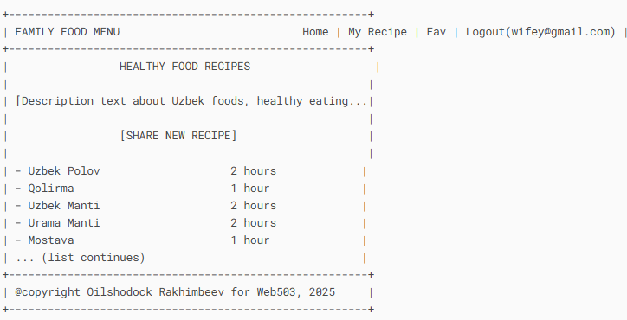
Wireframes

Slide 9
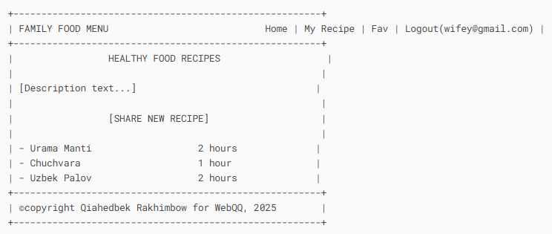
Wireframes

Slide 10
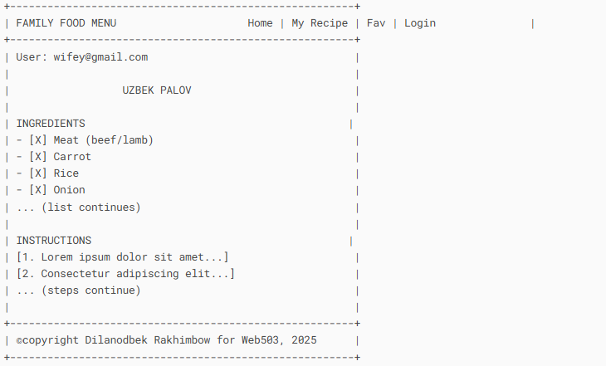
Wireframes

Slide 11
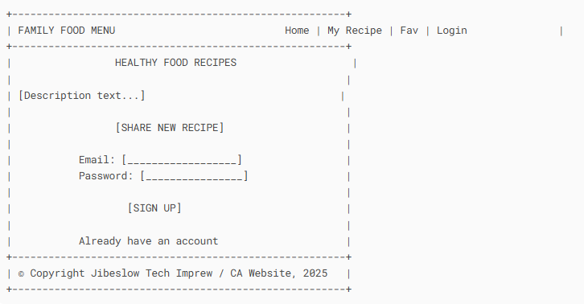
Wireframes

Slide 12

This is the end of my presentation Thank you for your attention.

